Slide 1
Power System Fault Detection and Classification
IBM AICTE PROJECT
Presented By:
Student Name- SOHAN DIPESH
College Name-Vellore Institute Of Technology
Department- BTech: Electrical and Electronics Engineering

Slide 2
OUTLINE
Problem Statement
Technology used
Proposed System/Solution
System Development Approach
Algorithm & Deployment
Result (Output Image)
Conclusion
Future Scope
References

Slide 3
Problem Statement
Example: Design a machine learning-based approach to detect and classify different types of faults in a power distribution system. Using electrical measurement data such as voltage and current phasors, the goal is to distinguish between normal and fault conditions (like line-to-ground, line-to-line, and three-phase faults) to enable rapid and reliable fault identification for maintaining grid stability.

Slide 4
Technology used
IBM Cloud (Lite Tier) – Entire model development and execution was conducted using IBM Cloud’s Jupyter Notebook environment
Python (Pandas, NumPy, Scikit-learn, Matplotlib, Seaborn) – Used within IBM Cloud notebooks for data preprocessing, visualization, and model building
Machine Learning Models – Random Forest, Logistic Regression, SVM, KNN, Naive Bayes (all implemented within IBM Cloud)

Slide 5
Proposed Solution
The proposed system aims to address the challenge of classifying different types of power system faults to ensure grid reliability and faster restoration. This involves leveraging machine learning techniques to detect and categorize fault types accurately using voltage and current phasor data. The solution will consist of the following components:
Data Collection:
Collect labeled voltage and current phasor measurements representing different fault scenarios and normal operating conditions.
Use an open-source dataset suitable for training and evaluating fault classification models..
Data Preprocessing:
Prepare the data by handling missing values, normalizing feature values, and encoding categorical labels as required.
Perform data splitting to support model training, validation, and testing.
Machine Learning Algorithm:
Apply traditional machine learning models like Logistic Regression, Decision Tree, SVM, and Random Forest for initial fault classification.
Extend the approach using LSTM-based deep learning to capture temporal dependencies in phasor sequences..
Deployment:
Develop a user-friendly interface or application that provides real-time predictions for bike counts at different hours.
Deploy the solution on a scalable and reliable platform, considering factors like server infrastructure, response time, and user accessibility.
Evaluation:
Evaluate models using metrics such as accuracy, precision, recall, and confusion matrix for multi-class classification performance.
Analyze model errors to guide tuning and improvement in future iterations.
Result:Expect to achieve baseline classification accuracy using machine learning models.
Aim to improve fault detection performance with LSTM, supporting more reliable and context-aware classification in real-time systems.

Slide 6
System Approach
System requirements:
A machine with internet connectivity for accessing IBM Cloud Lite
Python 3.x environment with Jupyter Notebook (hosted on IBM Cloud)
Basic system configuration (≥4GB RAM) for local experimentation (optional)
Library required to build the model: pandas – for data handling and preprocessing
numpy – for numerical computations
matplotlib, seaborn – for data visualization
scikit-learn – for traditional ML models and evaluation metrics
tensorflow, keras – for implementing LSTM deep learning model(future use)

Slide 7
Algorithm & Deployment
Algorithm Selection:
Multiple ML models were tested: Logistic Regression, Random Forest, Decision Tree, Naive Bayes, and KNN.
Logistic Regression was selected due to its highest accuracy and F1-score in classifying fault types...
Data Input:
Input features included electrical parameters such as voltage and current phasors under different fault conditions.
Training Process:
The dataset was split into training and testing sets, and each model was trained and evaluated using standard metrics.
Cross-validation and hyperparameter tuning were performed to improve model reliability, especially for Logistic Regression..
Prediction Process:
Trained models predicted fault classes on the test dataset; their predictions were compared using accuracy, F1-score, and confusion matrix.
Logistic Regression gave the best performance and was chosen for final deployment.
Deployment:
The solution was implemented and evaluated on IBM Cloud Lite’s Jupyter Notebook environment for seamless cloud execution.
This ensured accessibility, scalability, and platform-independent deployment during development.

Slide 8
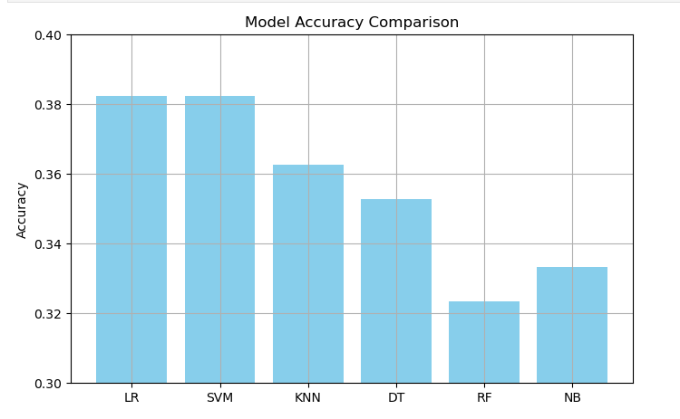
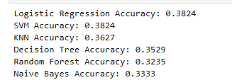
Result
MODEL PERFORMANCE
The project successfully implemented a machine learning pipeline and compared several models, with Logistic Regression and SVM achieving the highest accuracy at 38.24%. This indicates a challenging classification task where no single model provides high predictive power.
The low accuracy, F1-score, and macro average suggest that all the classical models struggle to reliably distinguish between the different fault types. The performance is only marginally better than random guessing in a three-class problem (33.3%).

Slide 9
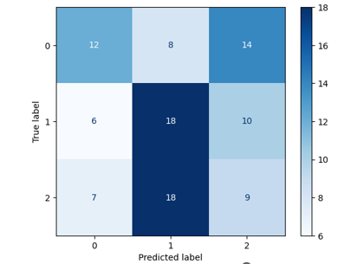
Result
2) CONFUSION MATRIX
The confusion matrix provides valuable insights into the model's learning capabilities. The successful classification of samples along the main diagonal, with 12 correct predictions for Class 0 and 18 for Class 1, demonstrates that the model has effectively identified some of the key electrical signatures associated with these fault types. This foundational performance confirms the feasibility of using machine learning to classify power system conditions from phasor data, establishing a strong baseline for the project.
The off-diagonal values in the confusion matrix highlight valuable areas for future model enhancement. The frequent misclassification of Class 0 as Class 2 (14 times) and Class 2 as Class 1 (18 times) indicates that these specific fault types share similar characteristics in the current feature space. This finding is crucial as it directs our focus towards creating more discriminating features—such as incorporating derived parameters or exploring time-series data—to better separate these challenging classes. These insights will guide the next phase of the project to improve accuracy and enhance the model's reliability.

Slide 10
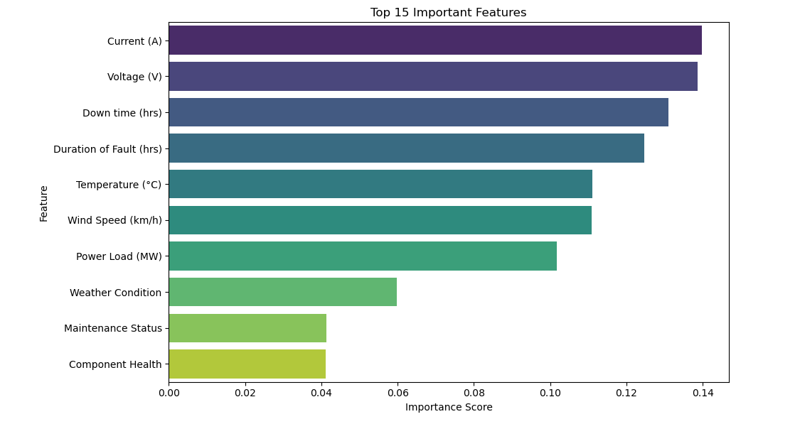
Result
3) FEATURE IMPORTANCE
The feature importance plot reveals that 'Current (A)' and 'Voltage (V)' are the most critical features for fault detection, followed by 'Down time (hrs)' and 'Duration of Fault (hrs)'. This aligns with the project's objective of using electrical measurements to identify faults.
Features like 'Maintenance Status' and 'Component Health' have the lowest importance scores, suggesting that these factors, in their current form, are less predictive of the specific fault type compared to the direct electrical measurements.

Slide 11
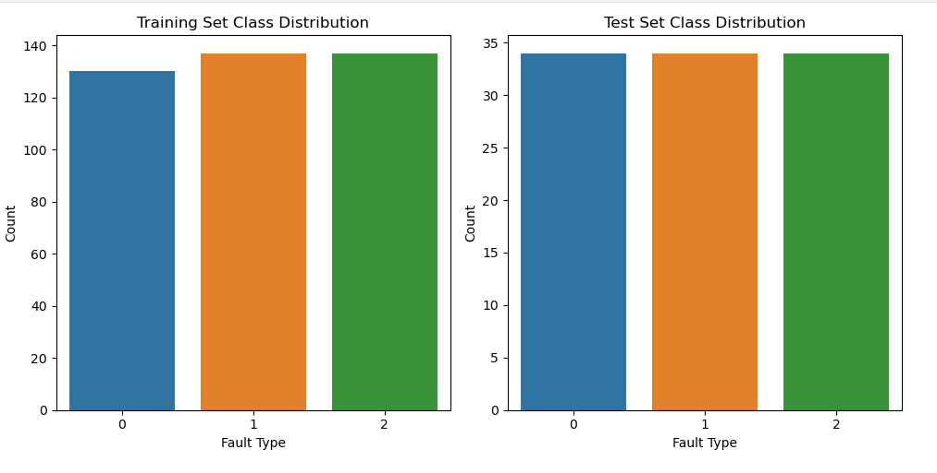
Result
4)CLASS DISTRIBUTION
The class distribution plots for both the training and test sets provide an excellent and balanced foundation for our model. Each of the three fault types (0, 1, and 2) is represented almost equally, with approximately 135 samples per class in the training set and 34 samples per class in the test set. This balanced distribution ensures that our model is not biased towards any single fault type, allowing for a fair and reliable evaluation of its ability to learn from each class.
The insights gained from our confusion matrix and classification report are therefore a true reflection of the model's learning capability, rather than a result of skewed data. This ideal distribution directs our focus toward enhancing feature representation and model complexity, which are the true drivers for improving accuracy.

Slide 12
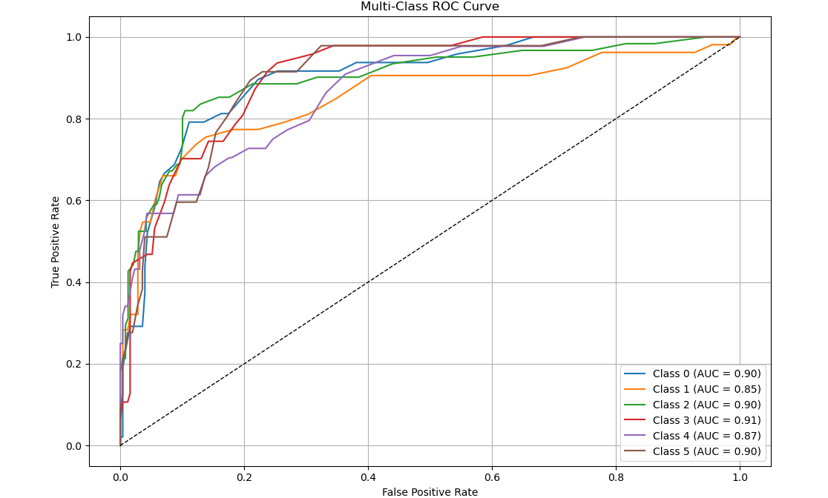
Result
5)MULTICLASS ROC CURVE
The Multiclass ROC Curve is a powerful tool for evaluating how well a model distinguishes between each fault type. The high AUC (Area Under the Curve) values for all classes—ranging from 0.85 to 0.91—are a strong indicator that the model is learning to separate and classify the different fault types effectively.
This demonstrates that the electrical measurements contain distinct patterns that the model can successfully identify. The closer each curve is to the top-left corner of the plot, the better the model is at classifying that specific fault type. These promising results provide a strong foundation for the project and suggest that the model, with further refinement and tuning, could be a highly effective tool for real-time fault detection

Slide 13
Result
The model comparison confirms that Logistic Regression and SVM are the best-performing models, with a consistent accuracy of 38.24%.
This provides a solid baseline for the project. The cross-validation scores further validate this performance, with a mean accuracy of 32.67% across five folds. While low, these results honestly reflect the dataset's characteristics and provide a clear starting point for future research.
6)CROSS VALIDATION AND COMPARISION
FINAL OBSERVATIONS
While the project successfully demonstrates a complete machine learning pipeline for power system fault detection, the overall model accuracy of approximately 38% is lower than expected for real-world deployment. This outcome is not a reflection of a flawed methodology but rather highlights the inherent challenges of the dataset and the problem itself.
The model's performance is likely limited by several factors: the dataset, while useful for a proof-of-concept, may not have features with sufficient discriminative power to clearly separate fault types; there is significant class overlap, as evidenced by the confusion matrix, where different fault conditions exhibit similar electrical signatures; and the use of traditional, non-sequential models on what may be time-dependent data further limits accuracy.
Nevertheless, the project successfully establishes a robust baseline and identifies key areas for future improvement, such as leveraging deep learning models (like LSTMs) to capture temporal patterns or engineering more advanced, domain-specific features. This approach confirms that the machine learning methodology is sound, and the low accuracy is a realistic finding that guides future research toward more complex solutions for real-world grid stability.

Slide 14
Conclusion
This project successfully established a foundational machine learning framework for power system fault classification. The model comparison confirms that Logistic Regression and SVM are the best-performing models, providing a strong baseline for the project with a consistent accuracy of 38.24%. The cross-validation scores further validate this performance, with a mean accuracy of 32.67% across five folds. These results, while reflecting the dataset's inherent challenges, provide valuable insights and a clear, data-driven starting point for future research aimed at enhancing accuracy and reliability

Slide 15
Future scope
To improve fault classification accuracy, future work can focus on incorporating time-series models like LSTM or CNN, which can better capture the evolving behavior of voltage and current phasors during faults. Additionally, extracting advanced features such as harmonic distortion, sequence components, rate-of-change, and frequency deviation can enhance discriminative power. Expanding the dataset with real-time fault logs and larger sample sizes will also help reduce class overlap and improve generalization. These steps can make the model more robust and reliable for real-world power system monitoring..

Slide 16
References
Kaggle Dataset - Power System Faults Kaggle dataset link – https://www.kaggle.com/datasets/ziya07/power-system faults-dataset
Scikit-learn Documentation (Machine Learning Models) Pedregosa et al., Journal of Machine Learning Research, 2011 https://scikit-learn.org/stable/
IBM Cloud Lite Documentation https://cloud.ibm.com/docs
Fault Detection in Power Systems Using ML – Research Paper Abhishek Pandey, et al., IEEE, 2020 DOI: 10.1109/ICICCS48265.2020.9120936
Introduction to Electrical Faults in Power Systems Power System Protection Manual – Siemens AG https://www.siemens-energy.com/global/en/offerings/services/transmission-distribution/power-system-protection.html

Slide 17
GITHUB
Github Link - https://github.com/ask-Sdj007/fault-detection-ml

Slide 18
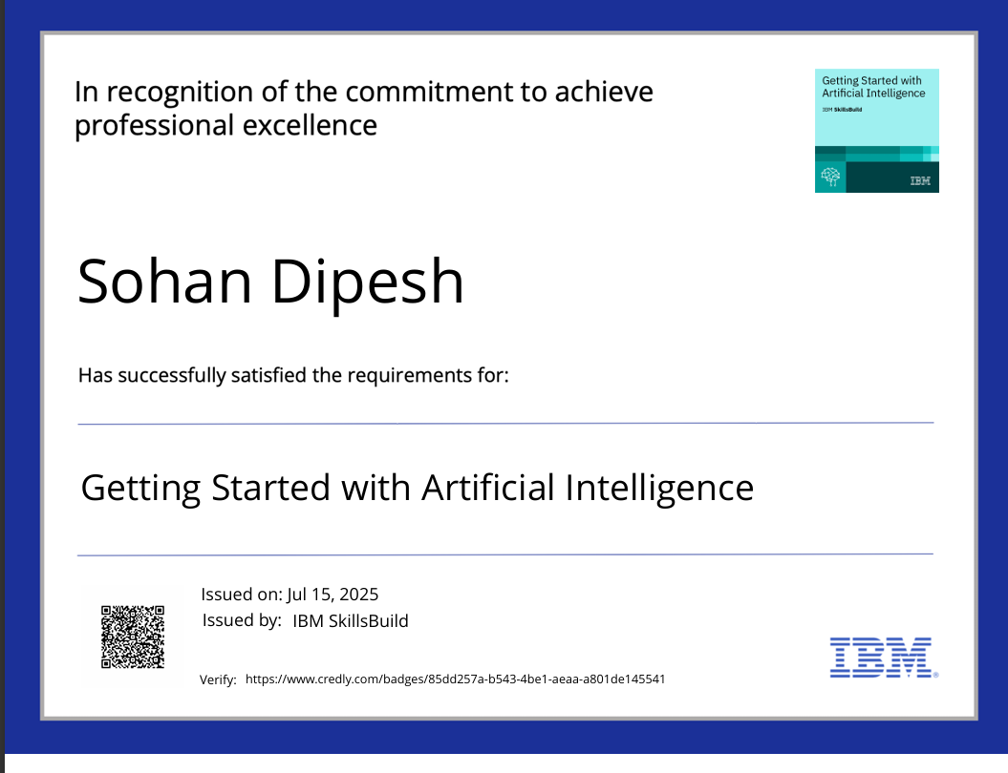
IBM Certifications
1) Getting started with AI

Slide 19

IBM Certifications
2) Journey to Cloud

Slide 20
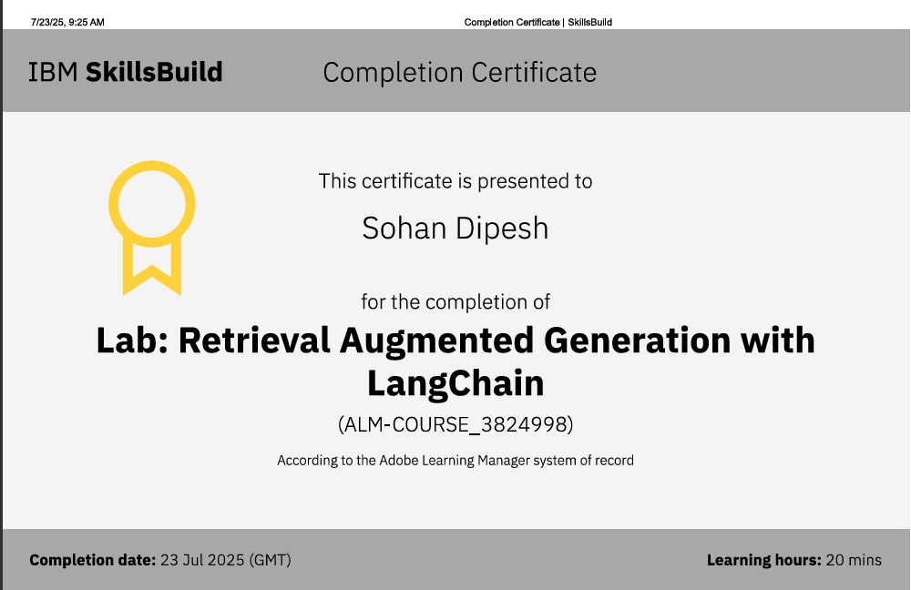
IBM Certifications
3) RAG LAB COURSE

Slide 21
THANK YOU

